Slide 1
University of Basrah
Al-Zahraa Medical College
Ministry of higher Education and Scientific Research
Academic year 2019-2020
3rd year S 5/6
Integrative Module
Session: 9
Date: 8/7/2020
Anaemia
Module staff:
Dr Ihsan Mardan (module leader)
Dr Jawad Ramadhan Dr Firas Rashid
Dr Miami Kadhum Dr Rehab A. Jaafer
Dr Sadiq Khalaf Dr Nehaya Alaboody Dr Hussein Katei Dr Ansam Munadhel
Dr Hadeel Salman
Hoffbarands essential Hematology 7ed
A Beginners Guide to Blood Cells 2ed
You can contact us on the telegram

Slide 2
University of Basrah
Al-Zahraa Medical College
Ministry of higher Education and Scientific Research
Learning Outcomes:
After this session you should be able to:
Explain how the structure of red blood cells enables them to accomplish their various functions. LO1
Define and classify anaemia. LO2
Explain the physiological adaptations to anaemia, and the resulting clinical features. LO3
Describe the mechanisms of anaemia in the context of other diseases including the common ‘Anaemia of chronic disease’ LO4

Slide 3
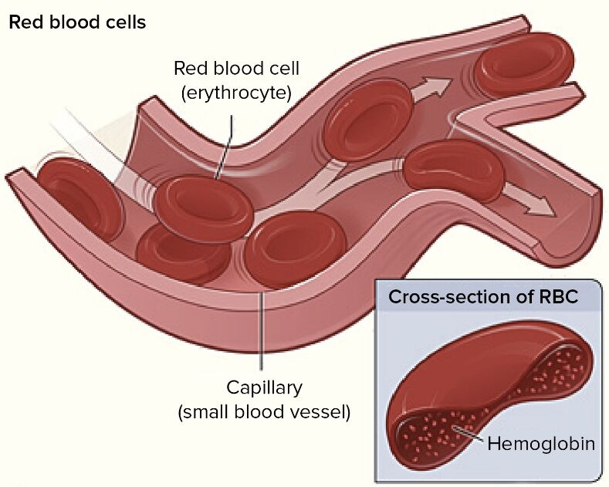
University of Basrah
Al-Zahraa Medical College
Ministry of higher Education and Scientific Research
LO1
The red cell:
In order to carry haemoglobin into close contact with the tissues and for successful gaseous exchange, the red cell, 8 μm in diameter, must be able to pass repeatedly through the microcirculation whose minimum diameter is 3.5 μm.
To fulfil these functions, the cell is a flexible biconcave disc with an ability to generate energy as adenosine triphosphate (ATP) by the anaerobic glycolytic pathway

Slide 4
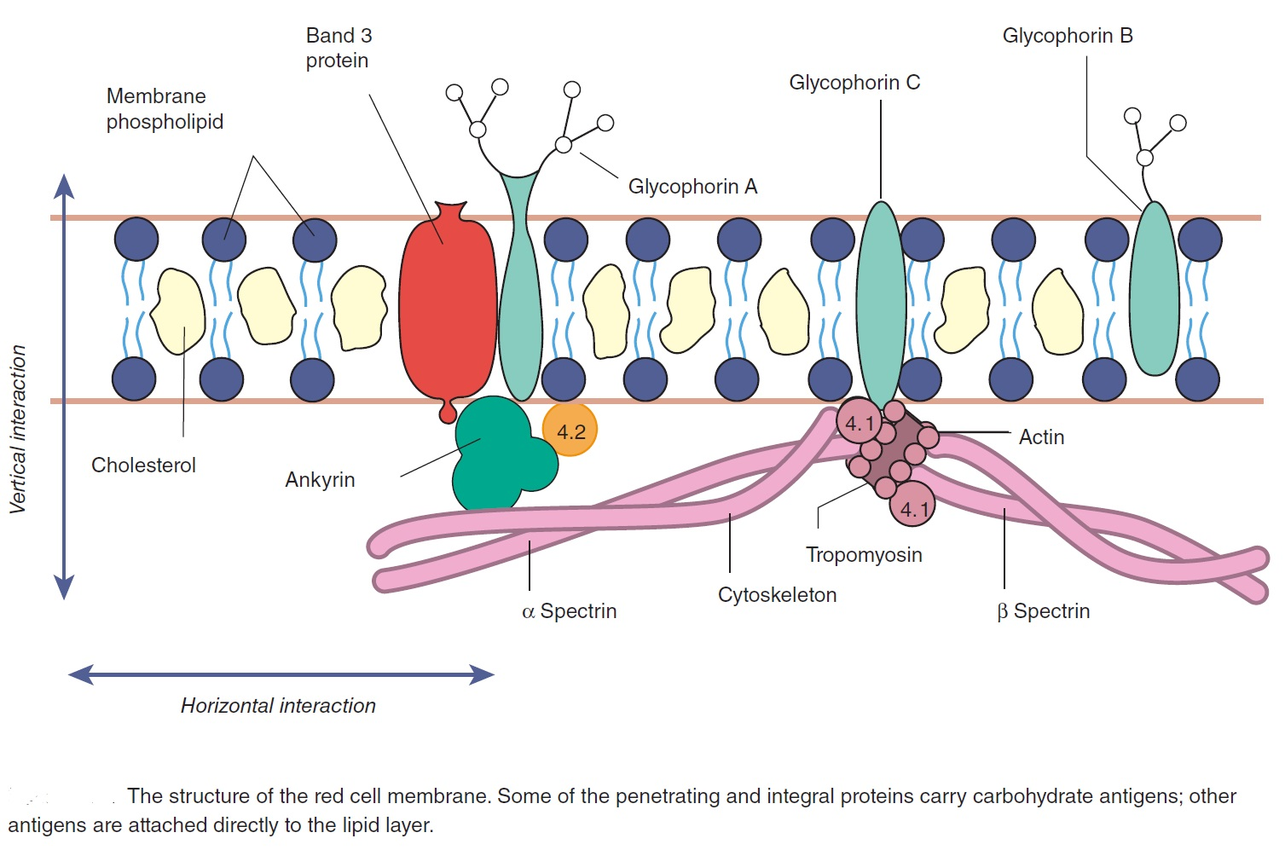
University of Basrah
Al-Zahraa Medical College
Ministry of higher Education and Scientific Research
Red cell membrane
The red cell membrane comprises a lipid bilayer, integral membrane proteins and a membrane skeleton.
Approximately 50% of the membrane is protein, 20% phospholipids, 20% cholesterol molecules and up to 10% is carbohydrate.
LO1

Slide 5
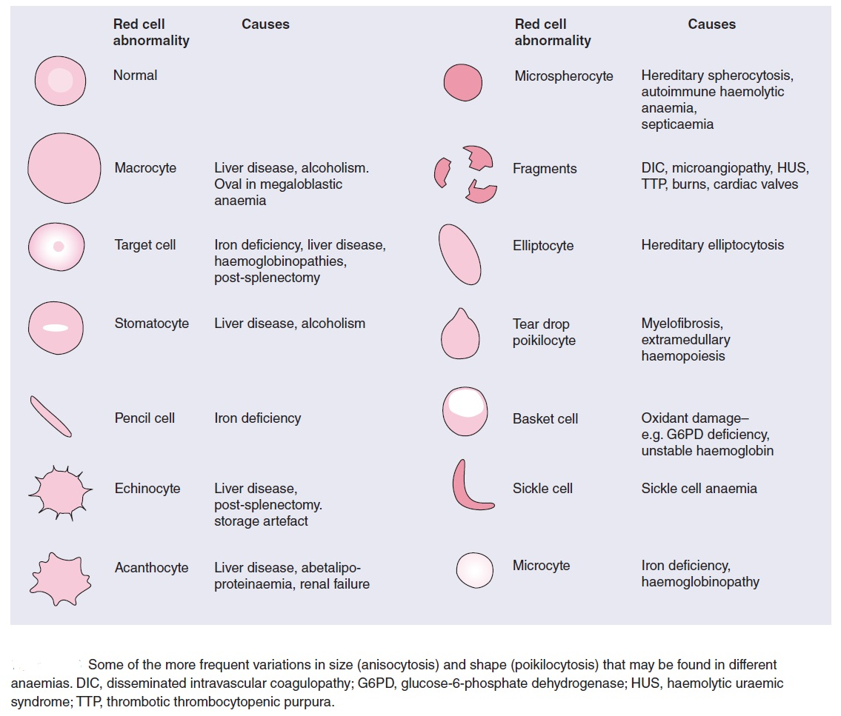
University of Basrah
Al-Zahraa Medical College
Ministry of higher Education and Scientific Research
Defects of the membrane proteins explain some of the abnormalities of shape of the red cell membrane (e.g. hereditary spherocytosis and elliptocytosis), while alterations in lipid composition because of congenital or acquired abnormalities in plasma cholesterol or phospholipid may be associated with other membrane abnormalities.
LO1

Slide 6
University of Basrah
Al-Zahraa Medical College
Ministry of higher Education and Scientific Research
LO1
Haemoglobin
The main function of red cells is to carry O₂ to the tissues and to return carbon dioxide (CO₂) from the tissues to the lungs.
In order to achieve this gaseous exchange they contain the specialized protein “haemoglobin”. Each molecule of normal adult haemoglobin A (Hb A) (the dominant haemoglobin in blood after the age of 3–6 months) consists of four polypeptide chains, α₂β₂, each with its own haem group.

Slide 7
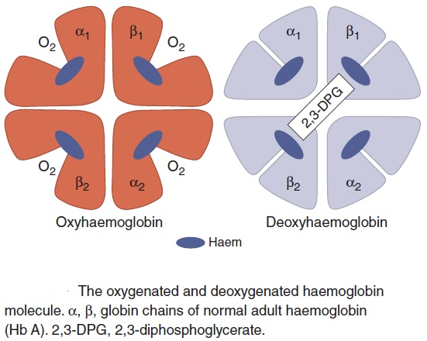
University of Basrah
Al-Zahraa Medical College
Ministry of higher Education and Scientific Research
LO1
Haemoglobin function
The red cells in systemic arterial blood carry O₂ from the lungs to the tissues and return in venous blood with CO₂ to the lungs.

Slide 8
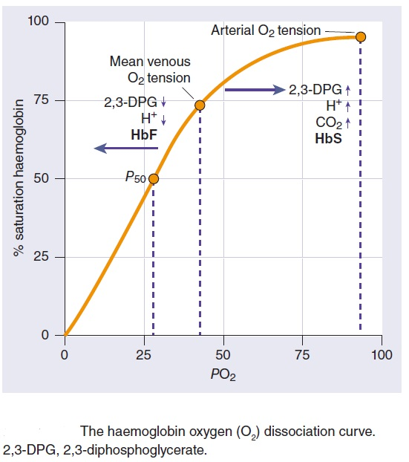
University of Basrah
Al-Zahraa Medical College
Ministry of higher Education and Scientific Research
LO1

Slide 9
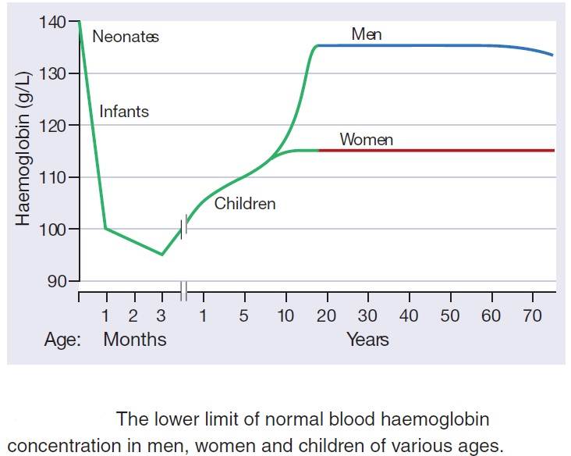
University of Basrah
Al-Zahraa Medical College
Ministry of higher Education and Scientific Research
Anaemia
This is defined as a reduction in the haemoglobin concentration of the blood below normal for age and sex.
LO2

Slide 10
University of Basrah
Al-Zahraa Medical College
Ministry of higher Education and Scientific Research
LO2
Polycythemia
Polycythaemia refers to an absolute increase in total body red cell volume (or mass), raised haemoglobin concentration and/or haematocrit/packed cell volume (TRUE polycythemia).
Alterations in total circulating plasma volume as well as of total circulating haemoglobin mass determine the haemoglobin concentration.
Reduction in plasma volume (as in dehydration) may mask anaemia or even cause (relative, pseudo) polycythaemia; conversely, an increase in plasma volume (as with splenomegaly or pregnancy) may cause anaemia even with a normal total circulating red cell and haemoglobin mass.

Slide 11
University of Basrah
Al-Zahraa Medical College
Ministry of higher Education and Scientific Research
LO2
Classification of anaemia according to mechanism
Blood loss
Reduced red cells life span (Haemolytic anaemia)
Intrinsic
Extrinsic
Inadequate production of red cells
Deficiency of iron, vit B₁₂ or folic acid
Aplastic anaemia
Bone marrow infiltration by malignant cells
Bone marrow fibrosis
Low affinity haemoglobin
Abnormal distribution of red cells within vasculature
hypersplenism

Slide 12
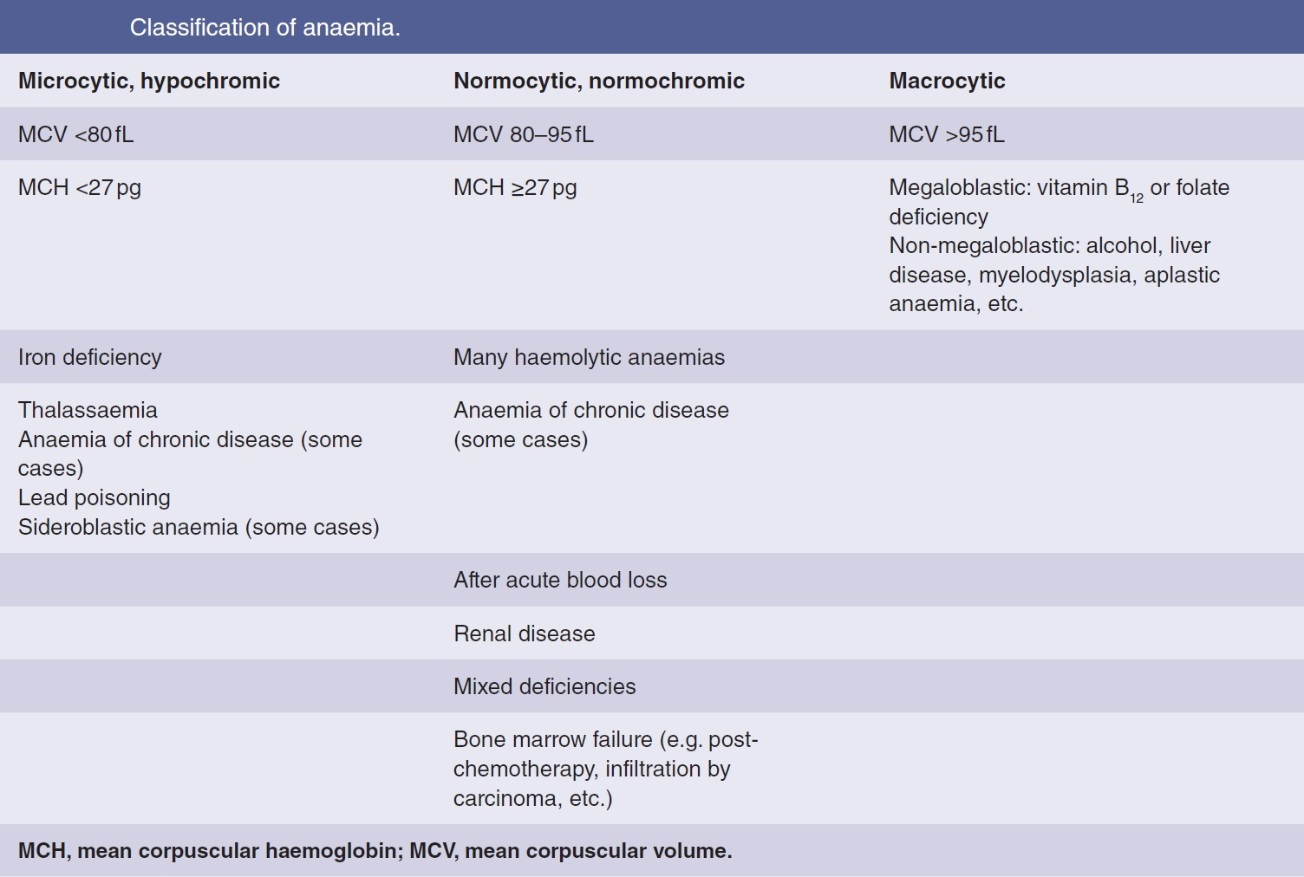
University of Basrah
Al-Zahraa Medical College
Ministry of higher Education and Scientific Research
LO2

Slide 13
University of Basrah
Al-Zahraa Medical College
Ministry of higher Education and Scientific Research
LO3
Introduction to haemolytic anaemias
- Normal red cell destruction usually occurs after a mean lifespan of 120 days when the cells are removed extravascularly by the macrophages of the reticuloendothelial (RE) system.
- Haemolytic anaemias are defined as anaemias that result from an increase in the rate of red cell destruction.
- Because of erythropoietic hyperplasia and anatomical extension of bone marrow, red cell destruction may be increased several‐fold before the patient becomes anaemic ”compensated haemolytic disease”.
- The normal adult marrow is able to produce red cells at 6–8 times the normal rate provided this is ‘effective’. It leads to a marked reticulocytosis. Therefore, anaemia due to haemolysis may not be seen until the red cell lifespan is less than 30 days.

Slide 14
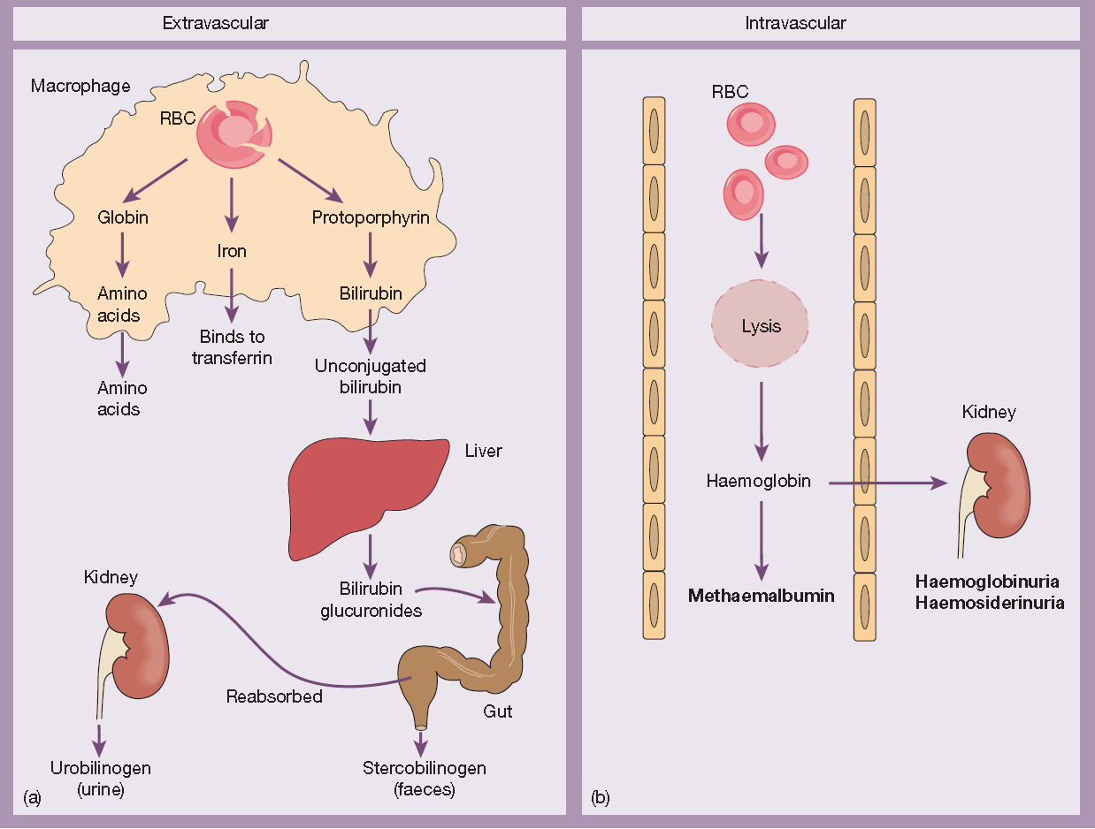
University of Basrah
Al-Zahraa Medical College
Ministry of higher Education and Scientific Research
The red cells may break down in the:
Reticuloendothelial system (extravascular): jaundice, gallstones and splenomegaly with raised reticulocytes and unconjugated bilirubin.
In the circulation (intravascular): (e.g. caused by ABO mismatched blood transfusion), there is haemoglobinaemia, methaemalbuminaemia, haemoglobinuria and haemosiderinuria.
LO3
(a) Normal red blood cell (RBC) breakdown. This takes place extravascularly in the macrophages of the reticuloendothelial system. (b) Intravascular haemolysis occurs in some pathological disorders.

Slide 15
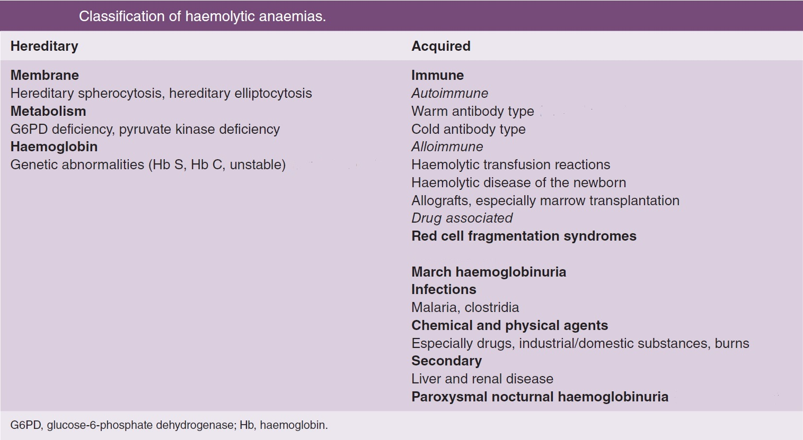
University of Basrah
Al-Zahraa Medical College
Ministry of higher Education and Scientific Research
Inherited red cell defects (intrinsic to the red cell)
Acquired causes (abnormality of the red cell environment) except PNH.
LO3

Slide 16
University of Basrah
Al-Zahraa Medical College
Ministry of higher Education and Scientific Research
Laboratory findings:
The laboratory findings are conveniently divided into three groups.
1 Features of increased red cell breakdown:
(a) serum bilirubin raised, unconjugated and bound to albumin;
(b) urine urinobilinogen increased;
(c) serum haptoglobins absent because the haptoglobins become saturated with haemoglobin and the complex is removed by RE cells.
2 Features of increased red cell production:
(a) reticulocytosis;
(b) bone marrow erythroid hyperplasia; the normal marrow myeloid:erythoid ratio of 2 : 1 to 12 : 1 is reduced to 1 : 1 or reversed.
3 Damaged red cells:
(a) morphology (e.g. microspherocytes, elliptocytes, fragments);
(b) osmotic fragility;
(c) specific enzyme, protein or DNA tests.
LO3

Slide 17
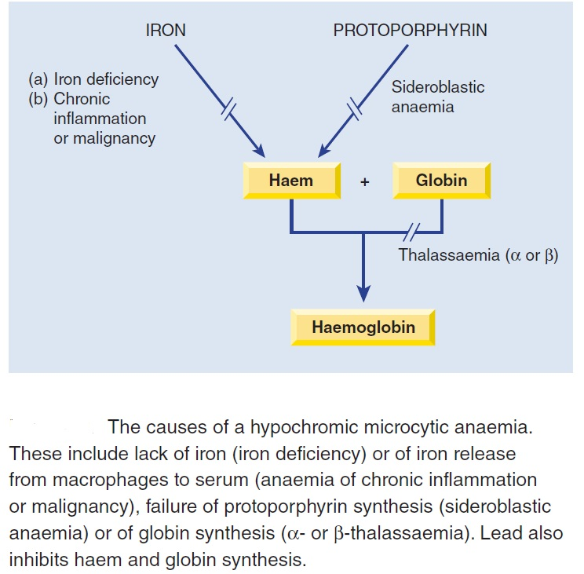
University of Basrah
Al-Zahraa Medical College
Ministry of higher Education and Scientific Research
Introduction to hypochromic microcytic anaemia
Iron deficiency is the major cause of a microcytic, hypochromic anaemia, in which the two red cell indices, mean corpuscular volume (MCV) and mean corpuscular haemoglobin (MCH), are reduced and the blood film shows small (microcytic) and pale (hypochromic) red cells.
LO4

Slide 18
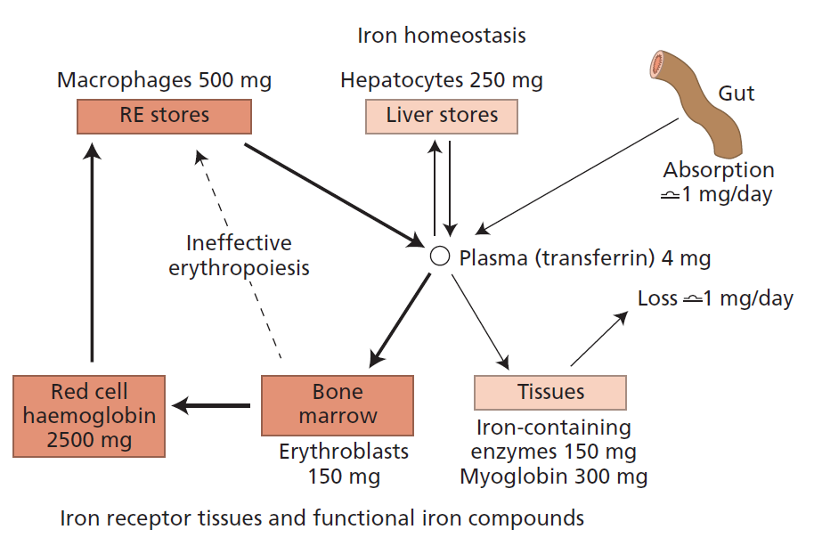
University of Basrah
Al-Zahraa Medical College
Ministry of higher Education and Scientific Research
LO4

Slide 19
University of Basrah
Al-Zahraa Medical College
Ministry of higher Education and Scientific Research
LO4

Slide 20
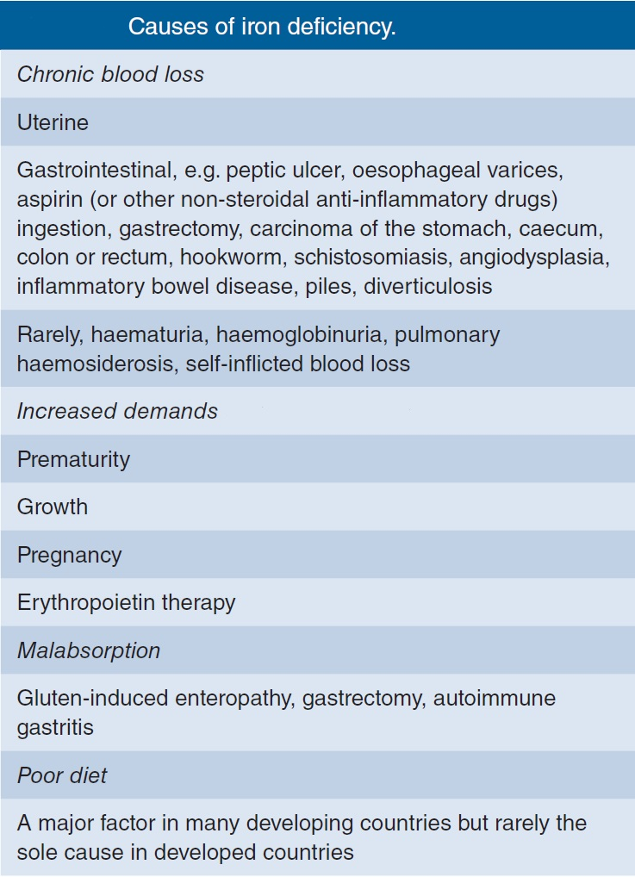
University of Basrah
Al-Zahraa Medical College
Ministry of higher Education and Scientific Research
LO4

Slide 21
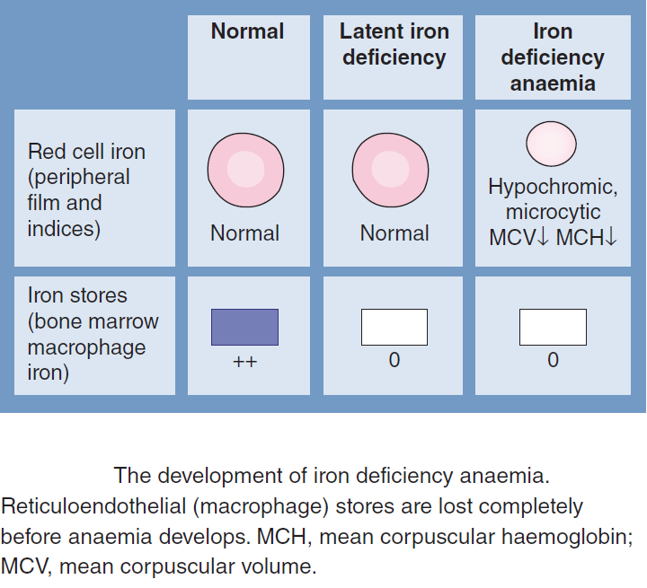
University of Basrah
Al-Zahraa Medical College
Ministry of higher Education and Scientific Research

Slide 22
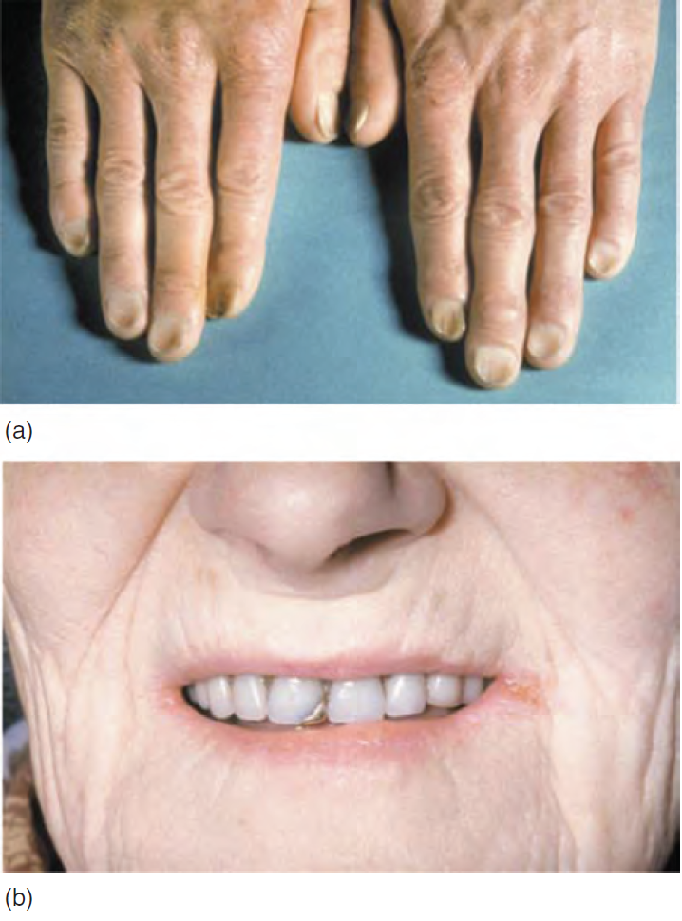
University of Basrah
Al-Zahraa Medical College
Ministry of higher Education and Scientific Research
Clinical presentation
General symptoms and signs of anaemia.
Painless glossitis,
Brittle, ridged or spoon nails (koilonychia)(a)
Angular stomatitis(b),
Unusual dietary cravings (pica)..
In children, iron deficiency is particularly significant as it can cause irritability, poor cognitive function and a decline in psychomotor development.
LO4

Slide 23
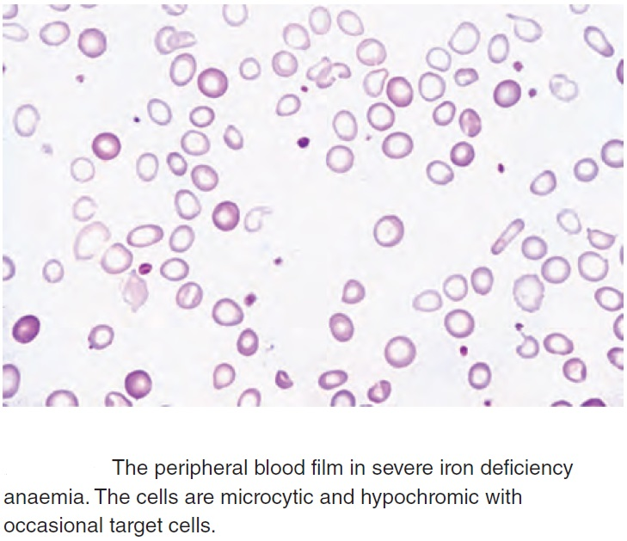
University of Basrah
Al-Zahraa Medical College
Ministry of higher Education and Scientific Research
Haematological findings
Even before anaemia occurs, the red cell indices fall and they
fall progressively as the anaemia becomes more severe.
LO4
The blood film shows hypochromic, microcytic cells with occasional target cells and pencil shaped poikilocytes
The reticulocyte count is low in relation to the degree of anaemia

Slide 24
University of Basrah
Al-Zahraa Medical College
Ministry of higher Education and Scientific Research
LO4
Anaemia of chronic disease
One of the most common anaemias
Normochromic, normocytic or mildly hypochromic (MCV rarely <75 fL) indices and red cell morphology.
Mild and non‐progressive anaemia (Hb rarely <90 g/L)
The pathogenesis of this anaemia appears to be related to:
decreased release of iron from macrophages to plasma because of raised serum hepcidin levels
reduced red cell lifespan
an inadequate erythropoietin response to anaemia caused by the effects of cytokines such as IL‐1 and tumour necrosis factor (TNF) on erythropoiesis.

Slide 25
University of Basrah
Al-Zahraa Medical College
Ministry of higher Education and Scientific Research
LO4

Slide 26
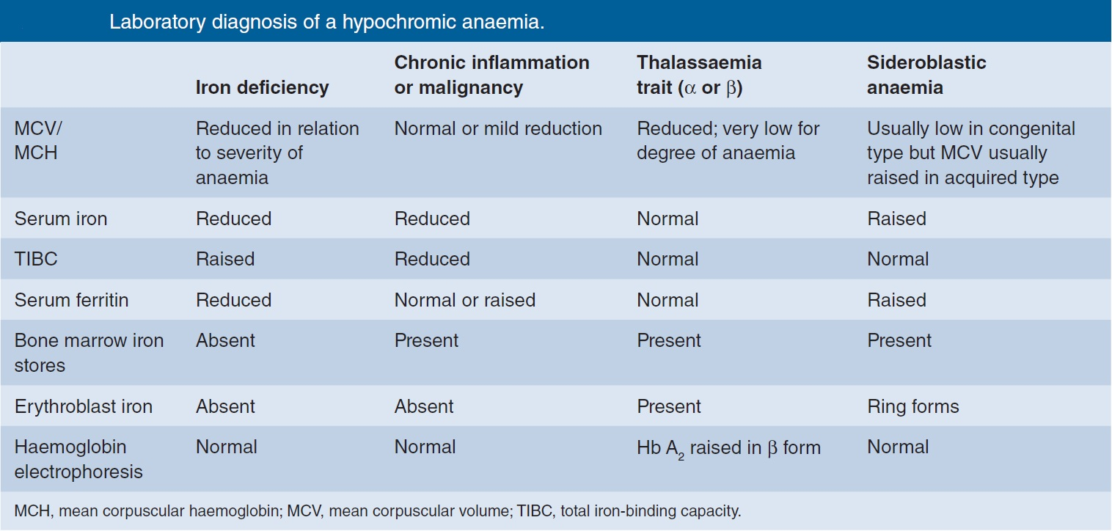
University of Basrah
Al-Zahraa Medical College
Ministry of higher Education and Scientific Research
LO2

Slide 27
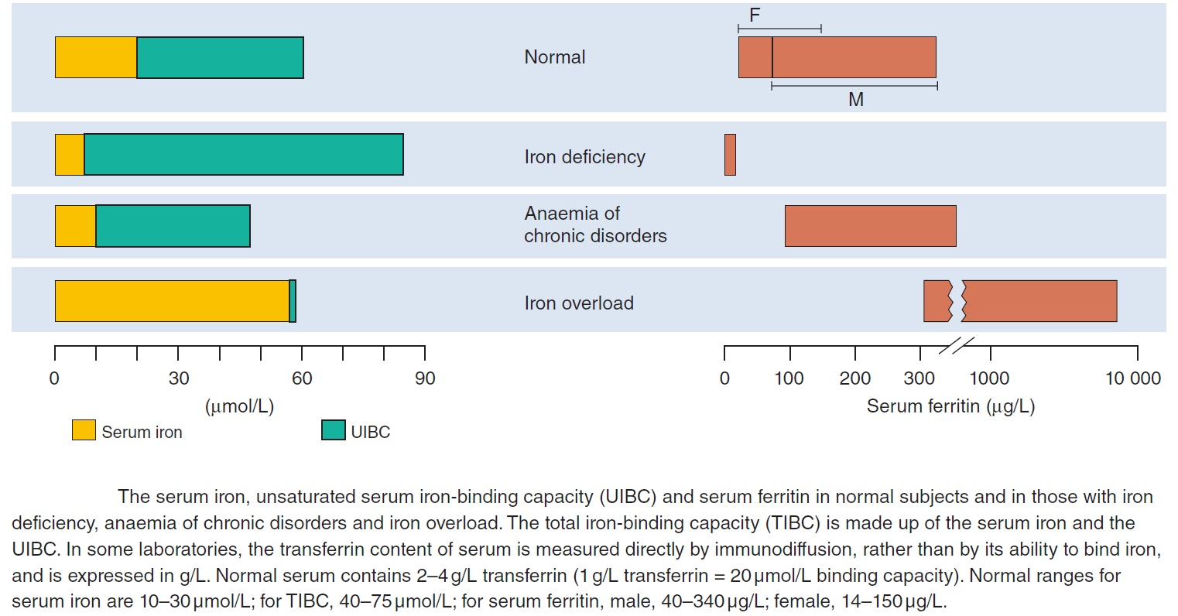
University of Basrah
Al-Zahraa Medical College
Ministry of higher Education and Scientific Research
LO4

Slide 28
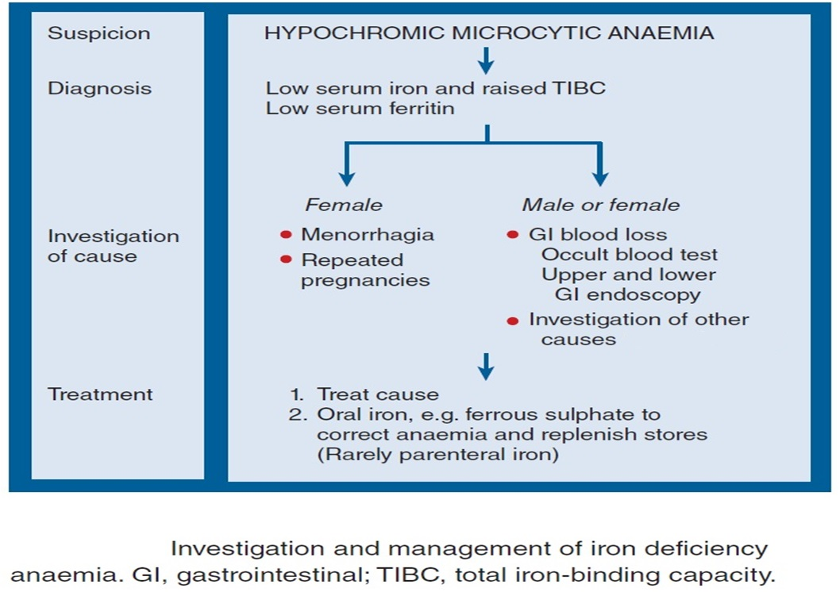
University of Basrah
Al-Zahraa Medical College
Ministry of higher Education and Scientific Research
LO4

Slide 29
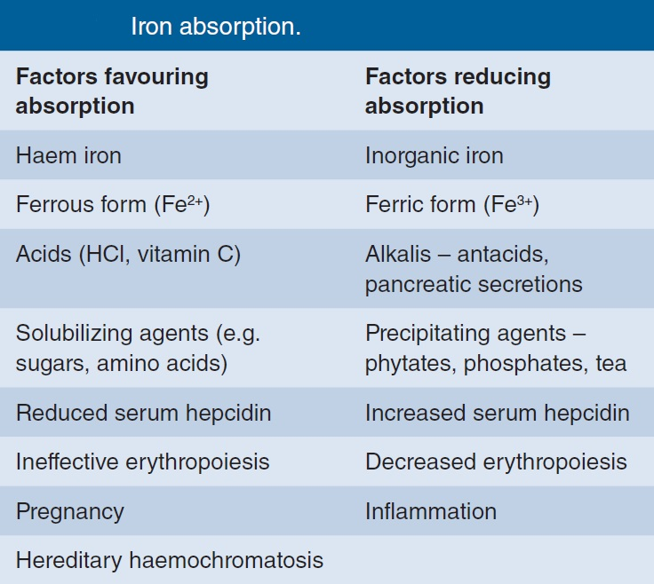
University of Basrah
Al-Zahraa Medical College
Ministry of higher Education and Scientific Research
LO4

Slide 30
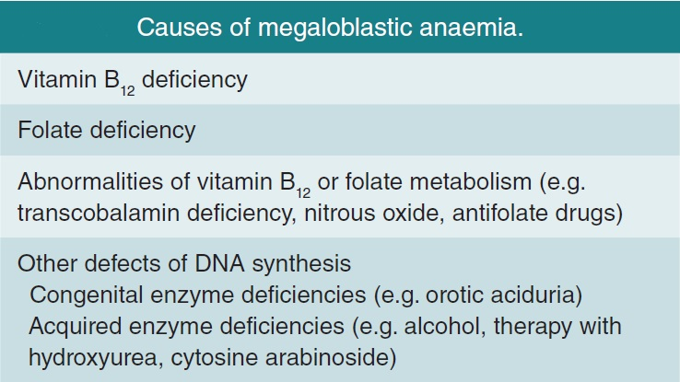
University of Basrah
Al-Zahraa Medical College
Ministry of higher Education and Scientific Research
Introduction to macrocytic anaemia
In macrocytic anaemia the red cells are abnormally large (mean corpuscular volume, MCV >95 fL).
There are several causes but they can be broadly subdivided into megaloblastic and non‐megaloblastic, based on the appearance of developing erythroblasts in the bone marrow.

Slide 31
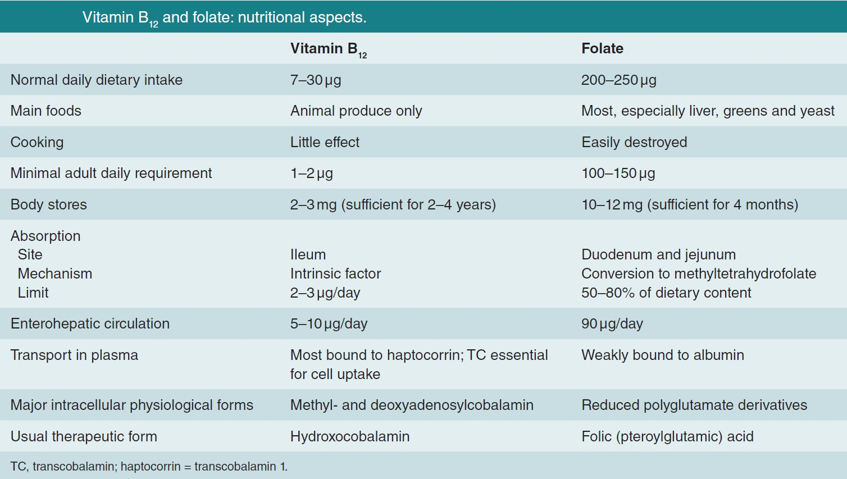
University of Basrah
Al-Zahraa Medical College
Ministry of higher Education and Scientific Research

Slide 32
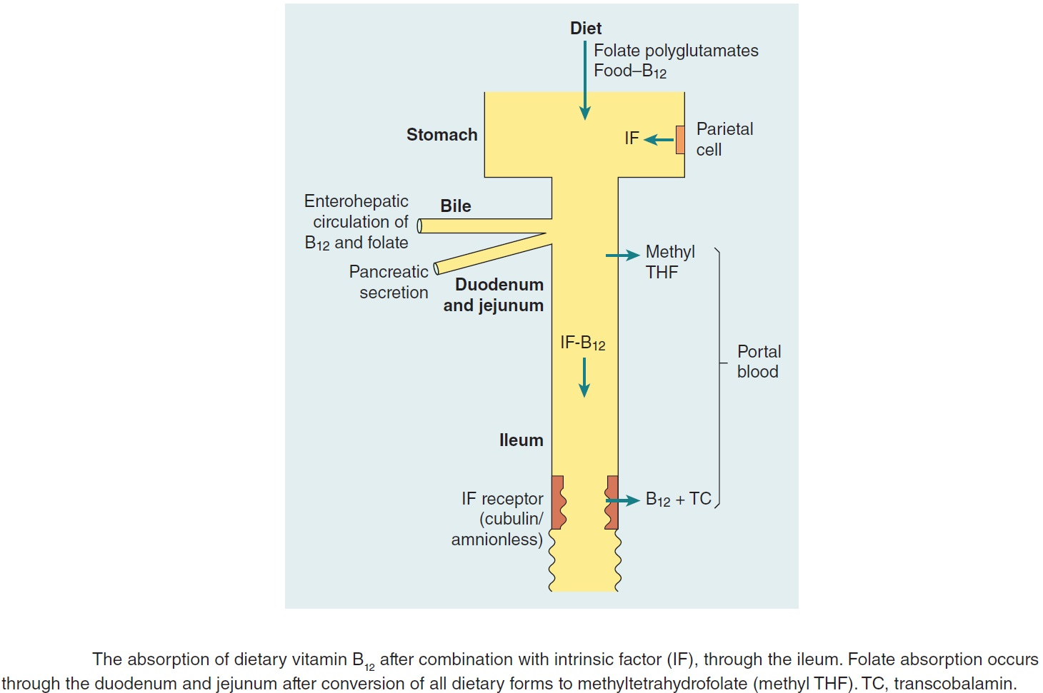
University of Basrah
Al-Zahraa Medical College
Ministry of higher Education and Scientific Research

Slide 33
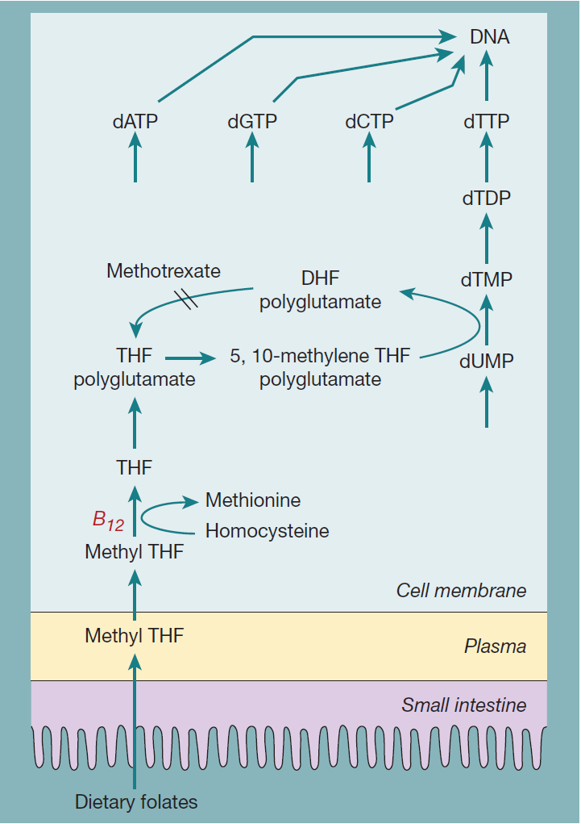
University of Basrah
Al-Zahraa Medical College
Ministry of higher Education and Scientific Research
The biochemical basis of megaloblastic anaemia caused by vitamin B₁₂ or folate deficiency. Folate is required in one of its coenzyme form, 5,10-methylene tetrahydrofolate (THF) polyglutamate, in the synthesis of thymidine monophosphate from its precursor deoxyuridine monophosphate. Vitamin B₁₂ is needed to convert methyl THF, which enters the cells from plasma, to THF, from which polyglutamate forms of folate are synthesized. Dietary folates are all converted to methyl THF (a monoglutamate) by the small intestine.

Slide 34
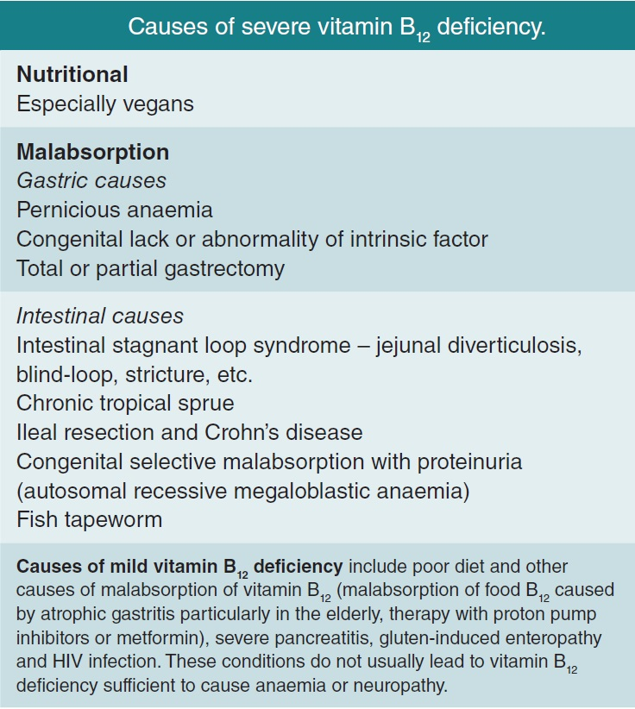
University of Basrah
Al-Zahraa Medical College
Ministry of higher Education and Scientific Research

Slide 35
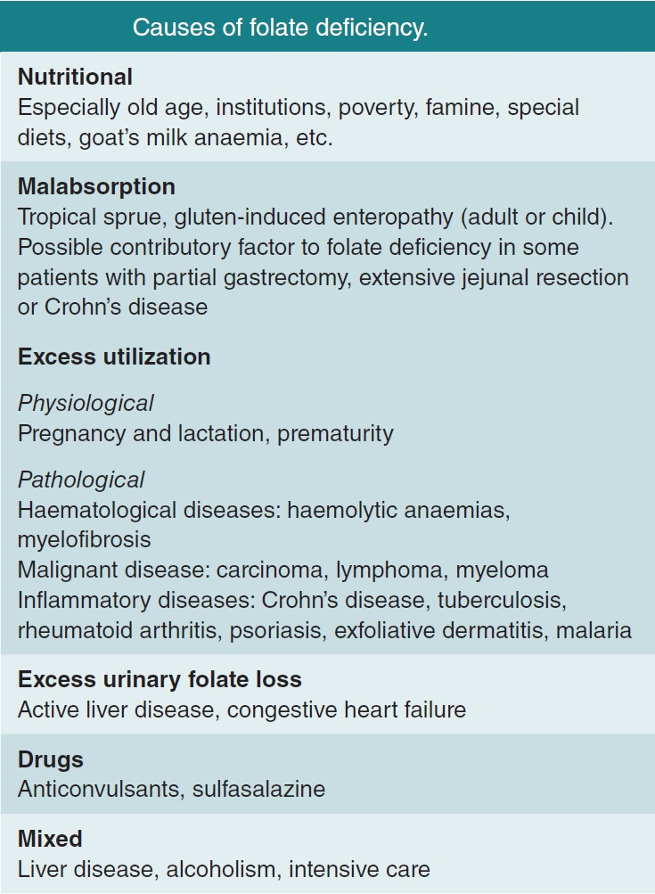
University of Basrah
Al-Zahraa Medical College
Ministry of higher Education and Scientific Research

Slide 36
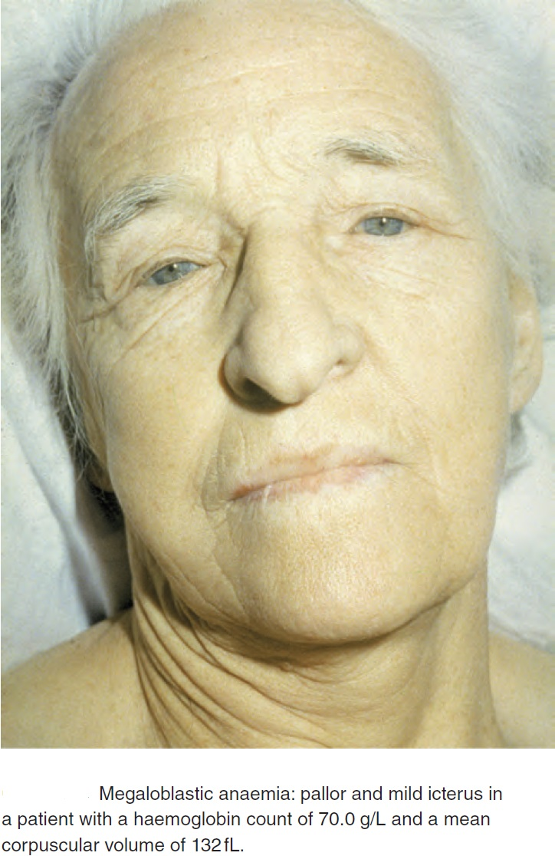
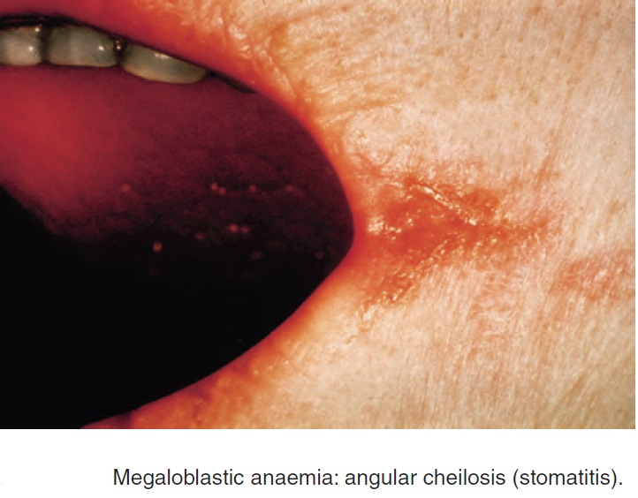
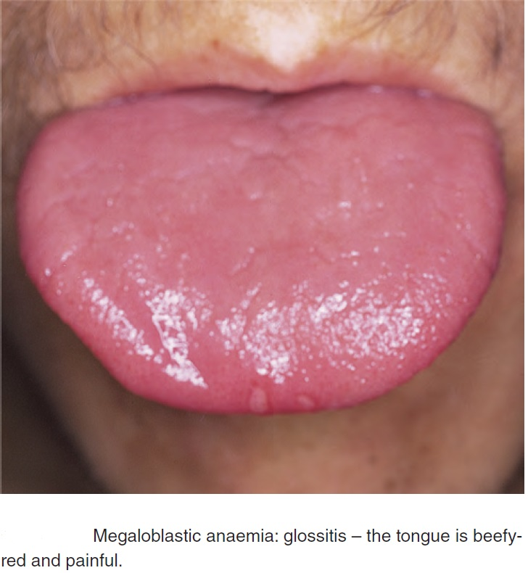
University of Basrah
Al-Zahraa Medical College
Ministry of higher Education and Scientific Research
Clinical features
The onset is usually insidious with gradually progressive symptoms and signs of anaemia
Mildly jaundiced (lemon yellow) increased ineffective erythropoiesis
Glossitis (a beefy‐red sore tongue)
Angular cheilosis
Mild symptoms of malabsorption with loss of weight may be present because of the epithelial
abnormality.
Purpura as a result of thrombocytopenia

Slide 37
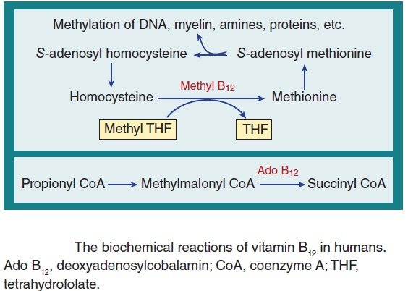
University of Basrah
Al-Zahraa Medical College
Ministry of higher Education and Scientific Research
Vitamin B12 neuropathy (subacute combined degeneration of the cord)
A progressive neuropathy affecting the peripheral sensory nerves and posterior and lateral columns. The neuropathy is symmetrical and affects the lower limbs more than the upper limbs.
Accumulation of S‐adenosyl homocysteine and reduced levels of S‐adenosyl methionine in nervous tissue resulting in defective methylation of myelin and other substrates.

Slide 38
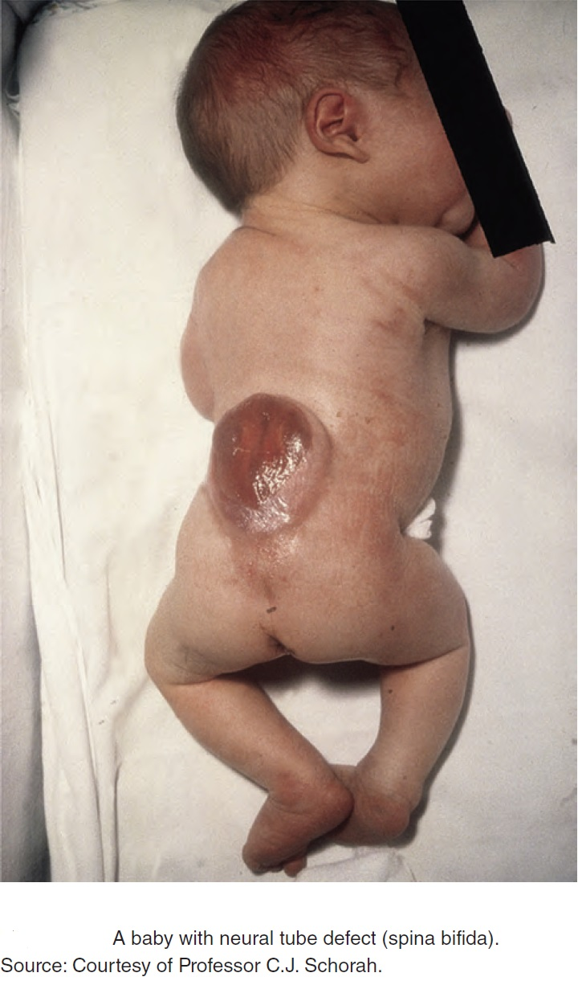
University of Basrah
Al-Zahraa Medical College
Ministry of higher Education and Scientific Research
Neural tube defect
Folate or B₁₂ deficiency in the mother predisposes to neural tube defect (NTD) (anencephaly, spina bifida or encephalocoele) in the fetus.
The lower the maternal serum or red cell folate or serum B₁₂ levels, the higher the incidence of NTDs.
Moreover, supplementation of the diet with folic acid at the time of conception and in early pregnancy reduces the incidence of NTD by 75%.

Slide 39
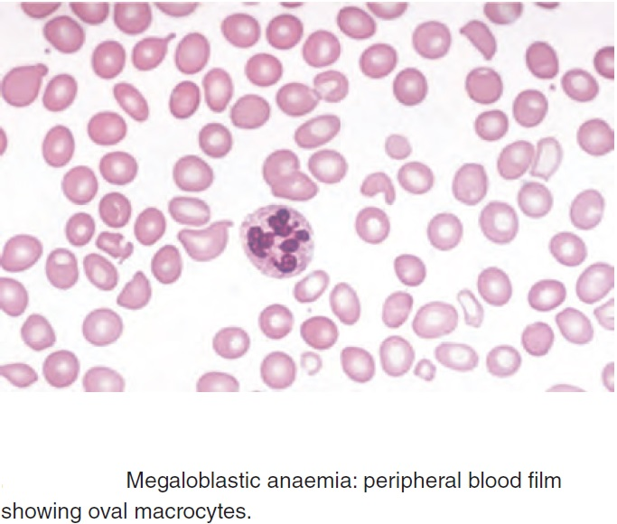
University of Basrah
Al-Zahraa Medical College
Ministry of higher Education and Scientific Research
Haematological findings
Macrocytosis (MCV >95 fL) 120–140 fL in severe cases)
Macrocytes are typically oval.
The reticulocyte count is low
WBC and PLT may be reduced (severe cases)
Hypersegmented neutrophils (with six or more lobes).
The bone marrow is hypercellular
-erythroblasts are large (open, fine, primitive chromatin but normal cytoplasmic haemoglobinization
-Giant metamyelocytes are characteristic

Slide 40
University of Basrah
Al-Zahraa Medical College
Ministry of higher Education and Scientific Research

Slide 41
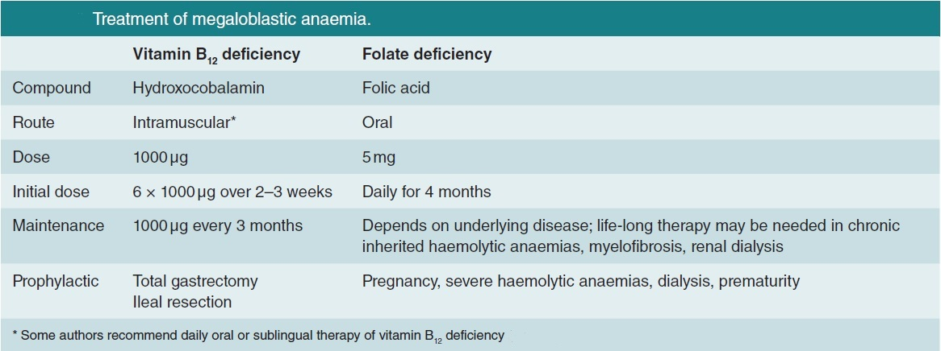
University of Basrah
Al-Zahraa Medical College
Ministry of higher Education and Scientific Research

Slide 42
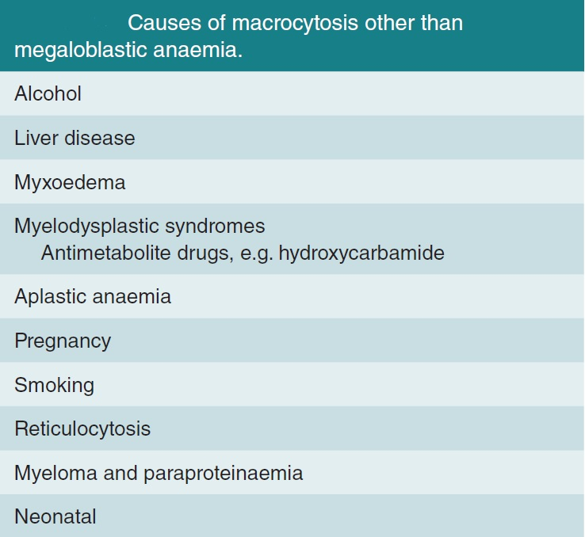
University of Basrah
Al-Zahraa Medical College
Ministry of higher Education and Scientific Research

Slide 43
University of Basrah
Al-Zahraa Medical College
Ministry of higher Education and Scientific Research
Many thanks for your attention

